Slide 1
Hack of the Drones
Technical Training Slide Show

Slide 2
We will cover*
Networking basics (TCP/IP 5 layer model)
WiFi basics
WiFi hacking (general concepts/methods)
WiFi hacking with Kali Linux
Parrot Drone attack methods
Demo and hands on learning
Questions?
* We can modify this at anytime based on class experience level. If the topics are too easy or too difficult please let us know, and we can adjust accordingly

Slide 3
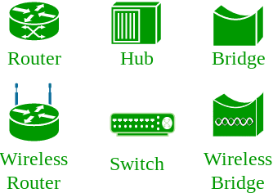
Networking basics
What is a computer network?
A computer network is a group of computer systems and other computing hardware devices that are linked together through communication channels to facilitate communication and resource-sharing.
Networks are made up of a variety of devices communicating over various mediums and can be wired or wireless
Common network devices:
- Router: interconnects networks and controls inter-network data flow - Switch: connects smaller segments of the network together - Hub: connects multiple devices into a single segment - Bridge: A single connection switch

Slide 4
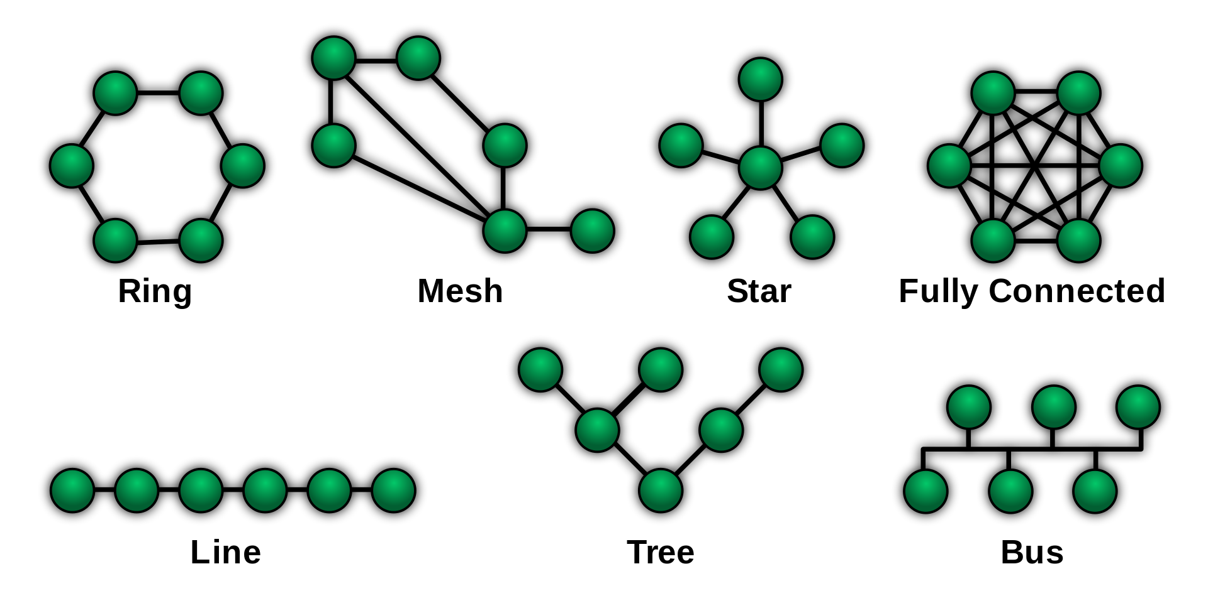
Networking basics
Network typologies:
The arrangement of the elements (links, nodes, etc.) of a communication network

Slide 5
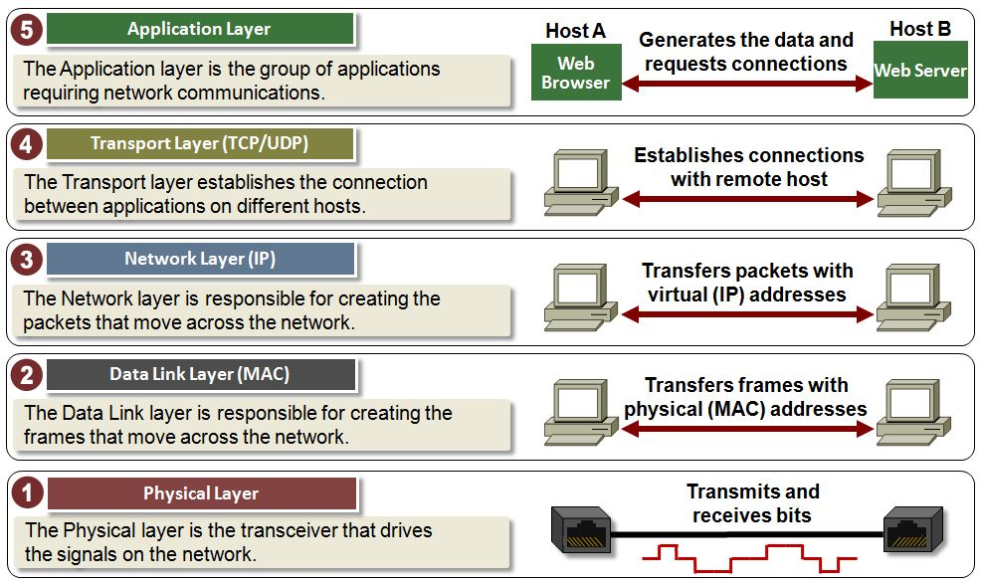
TCP/IP 5 layer model
The 5-layer model serves primarily the protocols known as Transmission Control Protocol (TCP) and Internet Protocol (IP), or jointly, TCP/IP
Called the “5 layer” model because it has 5 layers
encapsulation is the process of taking data from one layer and translating it into another layer
A protocol is a standard of communication that everyone using that method must follow

Slide 6
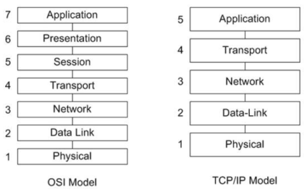
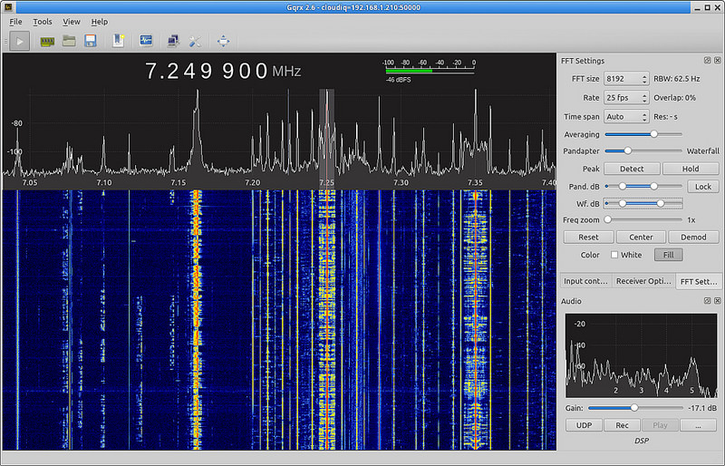
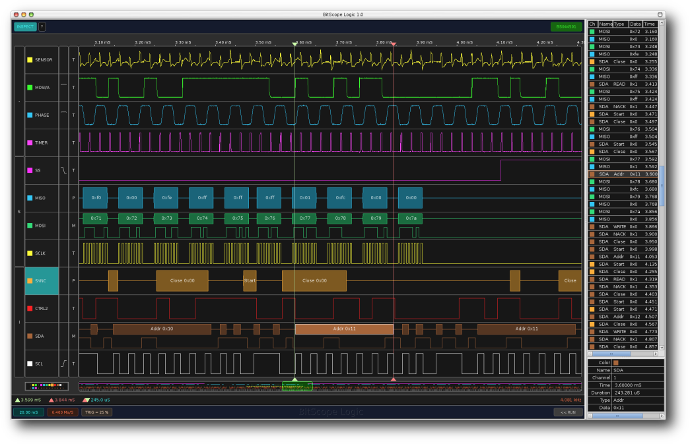
Layer 1: physical layer
The Physical layer encodes and decodes the actual bits of information sent over a communication channel
We typically refer to this as modulation
Devices that modulate/demodulate information are typically called transceivers
Information is sent as electromagnetic waves, photons, or electric current

Slide 7
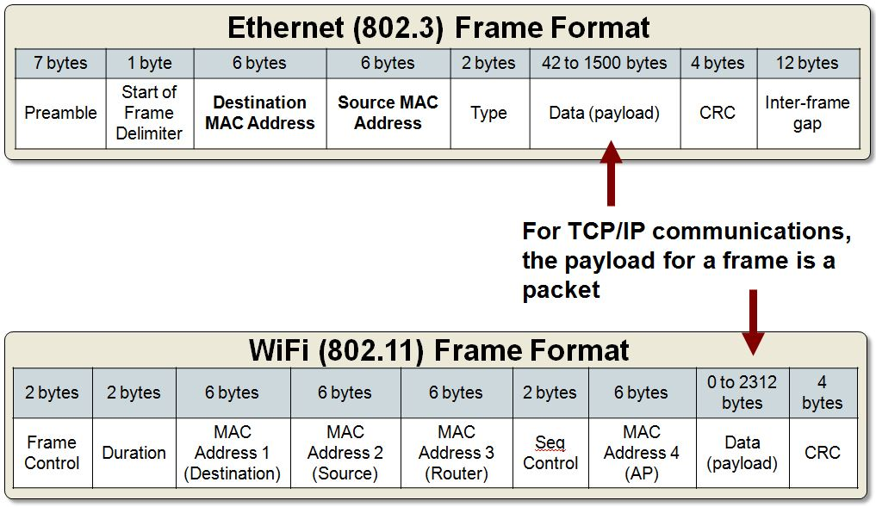
Layer 2: Data-link layer
The data-link layer addresses computers on the same network segment
A layer 2 PDU is called a “frame”
The address is the unique physical address of the computers, called the hardware address, and is tied to the networking card
The most common is the MAC (medium access control) address
This process can be a little confusing, let me know if you have any questions

Slide 8
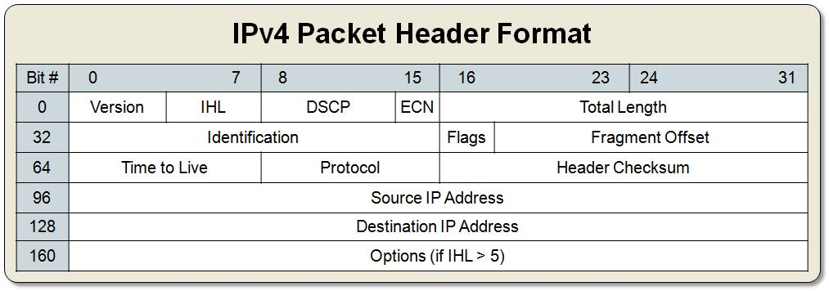
Layer 3: Network layer
The data-link layer addresses computers on different networks
The PDU at this layer is called a packet
responsible for creating the packets that move across the network. It uses IP addresses to identify the packet’s source and destination
While out of scope of this lecture, layer 3 has a lot more than just IP addresses

Slide 9
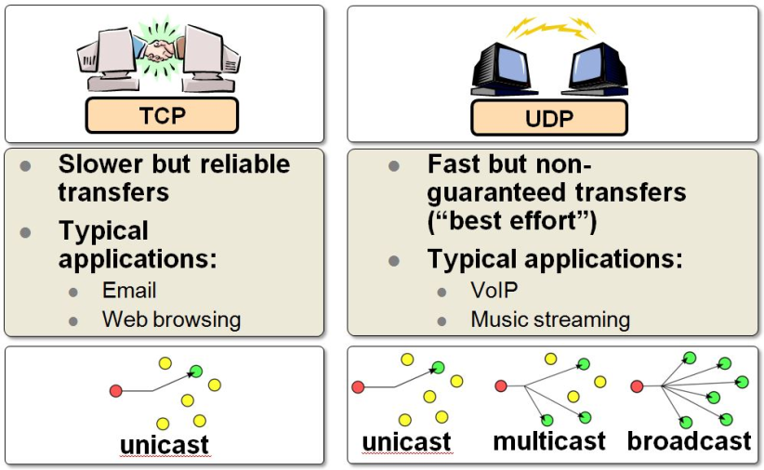

Layer 4: Transport layer
The Transport layer establishes the connection between applications running on different hosts.
It uses TCP for reliable connections and UDP for fast connections. PDU is a segment or datagram
It keeps track of the processes running in the applications above it by assigning port numbers to them and uses the Network layer to access the TCP/IP network.
TCP/UDP
App 1 (port 8675)
All inbound and outbound traffic
(all ports)
All inbound ans outbound traffic
App 2 (port 6001)
App 3 (port 9841)

Slide 10
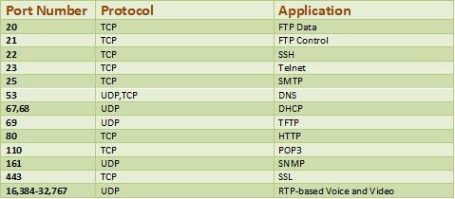
Layer 4: ports
The Internet Assigned Numbers Authority (IANA) manages the first 1024 ports (0 – 1023). This range is known as the Wellknown Port Numbers and includes standard default HTTP (port 80), FTP (port 21) and SMTP (port 25). These port numbers are reserved and should not be used arbitrarily.
The second range is the Registered Port Numbers which contains
ports 1024 through 49151. The Registered Port Numbers can be
used by ordinary programs and user processes that are executed
by the user. The use of specific port numbers is not carved in
stone. These ports are generally used transiently when needed.
The third range is the Dynamic or Private Port Numbers which
range from 49152 through 65535. These can be used by applications
and processes initiated by the user but it is uncommon. There are
known Trojan horse and backdoor programs that use this extreme
upper range so some security administrators are leery of
traffic in this range

Slide 11
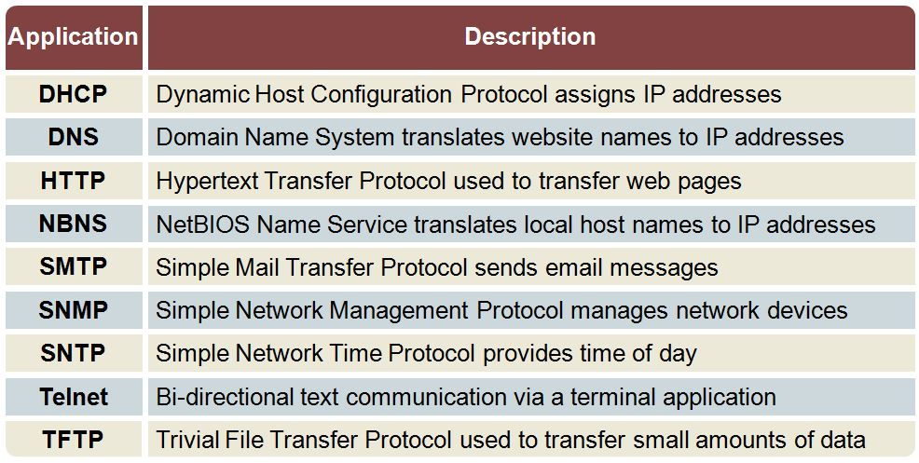
Layer 5: Application layer
The Application layer is composed of applications requiring network communications.
Examples of these applications include email clients and web browsers. These applications use the Transport Layer to send requests to connect to remote hosts.

Slide 12
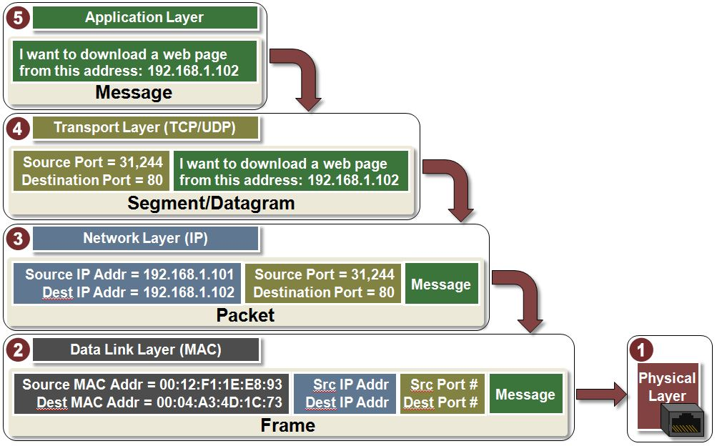
Putting it all together

Slide 13
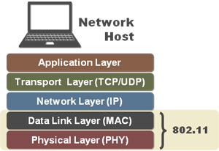
WiFi Basics
WiFi allows extending an ethernet IP network to operate over the air for access.
In other words, 802.11/Wi-Fi is a collection of protocols that replace an ethernet cable.
"802.11" and "Wi-Fi" are often used synonymously. Let's clarify these acronyms:
IEEE 802.11
Refers to the suite of standards for implementing wireless local area networks (WLANs), created and maintained by the IEEE Standards Committee.
Wi-Fi
A trademark owned by the Wi-Fi® Alliance (www.wi-fi.org), an industry trade association that promotes WLAN technology and certifies products if they conform to certain standards of interoperability.

Slide 14
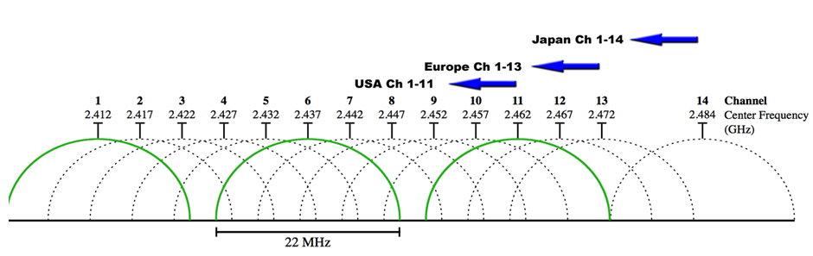
802.11 Channels
802.11 operates over 2 major spectral bands; the ISM band covering 2.4 GHz - 2.485 GHz spectrum, as well as the 5 GHz band.
The ISM band is divided into 14 channels at different frequencies. Center frequencies are separated by 5MHz (i.e. 2412, 2417, 2422 etc) however the bandwidth is +/- 10MHz, so there is significant spectral overlap on adjacent channels
Geographical location dictates which channels can be used:
US: Channels 1-11
Europe: Channels 1-13
Japan: Channels 1-14

Slide 15
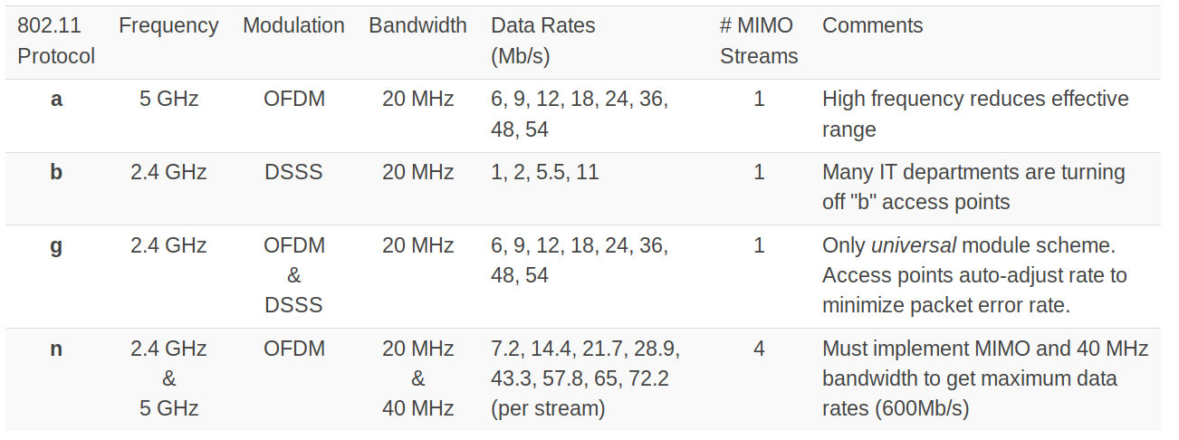
802.11 a/b/g/n ???
What does this all mean?
802.11a is used to isolate networks and avoid crowded 2.4GHz spectrum
802.11g are energy efficient radios and fully compatible with basic 802.11n networks.
802.11n is useful for high data throughput applications

Slide 16
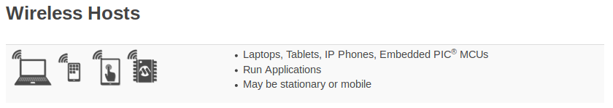
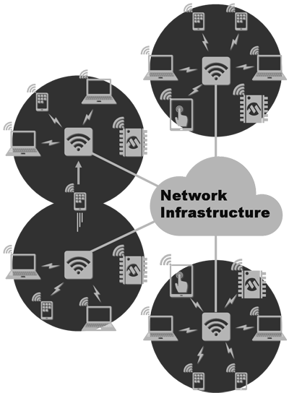
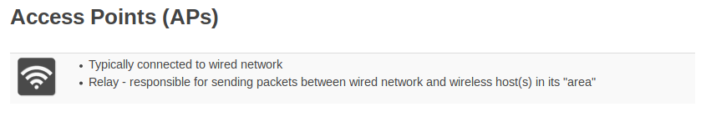
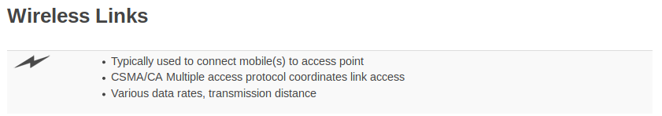
Hosts/Access Points/Links
Wireless Link Characteristics
Decreased signal strength: radio signal attenuates as it propagates through matter (path loss)
Interference from other sources: standardized wireless network frequencies (e.g., 2.4 GHz) shared by other devices (e.g., phone); devices (motors) interfere as well
Multipath propagation: radio signal reflects off objects ground, arriving at destination at slightly different times

Slide 17
Connecting to networks
The Wireless Host ("station") needs to associate with an access point (AP) before it can send/receive network-layer data. This is a basic 802.11 system management function.
Association = creation of a “virtual ethernet wire” between the station and the switch.
Basic 3-step procedure followed by the station:
Locate an AP to associate with, this process can involve passive or active scanning
Authenticate itself to the AP (and possibly the Infrastructure).
Associate with the AP (create the "virtual" blue cable).
Now, the station can retrieve an IP address from the subnet and begin TCP/UDP socket communications.

Slide 18
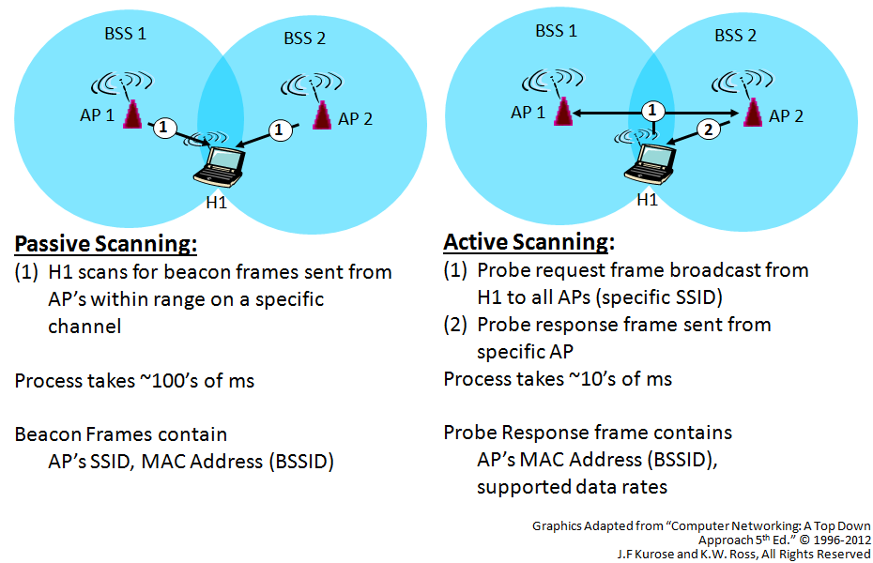
Locating

Slide 19
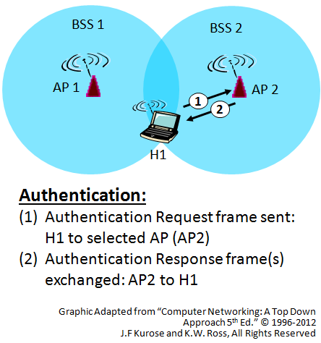
Authenticating
1. WPA2 + AES
2. WPA + AES
3. WPA + TKIP/AES (TKIP is there as a fallback method)
4. WPA + TKIP
5. WEP
6. Open Network (no security at all)

Slide 20
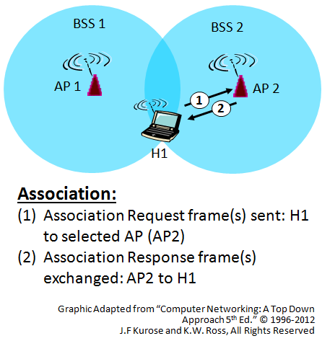
Associating
Associate:
Association request/response frames are exchanged.
Final bit rates and security parameters are agreed upon.
Now, 802.11 data frames can be sent between the station and AP.

Slide 21
WiFi Hacking

Slide 22
WiFi hacking
This will be how you will attack the drone
The drone is essentially a flying access point
We will briefly cover: - Scanning - Wifi de-authentication - WEP password cracking

Slide 23
Using airmon-ng to scan WiFi
Prior to looking for networks, you must put your wireless card into what is called “monitor mode”.
Monitor mode is a special mode that allows your computer to listen to every wireless packet. This monitor mode also allows you to optionally inject packets into a network.
To put your wireless card into monitor mode using airmon-ng:
>> airmon-ng start wlan0
It will create create another interface, and append “mon” to it. So, wlan0 will become wlan0mon. To confirm it is in monitor mode, run “iwconfig” and confirm the mode.

Slide 24
Using airmon-ng to scan for wifi networks
Then, start airodump-ng to look out for networks:
>> airodump-ng wlan0mon
airodump-ng hops from channel to channel and shows all access points it can receive beacons from
After a short time some APs and (hopefully) some associated clients will show up.

Slide 25
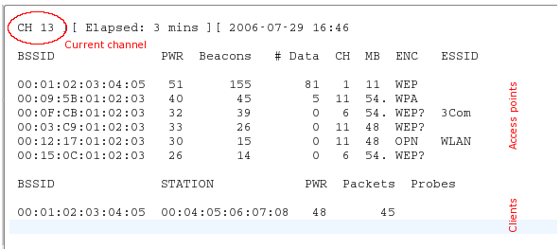

Slide 26
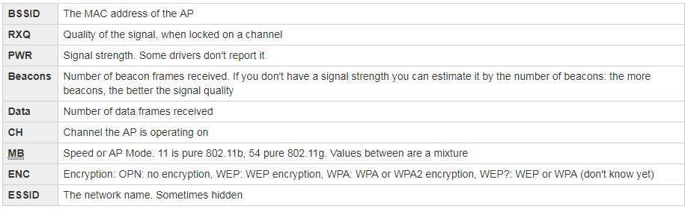
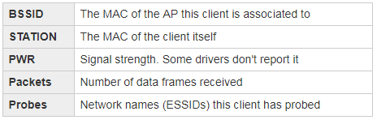
Access Point Information
Client Information

Slide 27
De-authentication using airplay-ng
This attack sends disassocate packets to one or more clients which are currently associated with a particular access point. Disassociating clients can be done for a number of reasons:
Recovering a hidden ESSID. This is an ESSID which is not being broadcast. Another term for this is “cloaked”.
Capturing WPA/WPA2 handshakes by forcing clients to reauthenticate
Generate ARP requests (Windows clients sometimes flush their ARP cache when disconnected)

Slide 28
Example…
>> aireplay-ng -0 1 -a 00:14:6C:7E:40:80 -c 00:0F:B5:34:30:30 ath0
Where: -0 means deauthentication
1 is the number of deauths to send (you can send multiple if you wish); 0 means send them continuously
-a 00:14:6C:7E:40:80 is the MAC address of the access point
-c 00:0F:B5:34:30:30 is the MAC address of the client to deauthenticate; if this is omitted then all clients are deauthenticated
ath0 is the interface name

Slide 29
Troubleshooting
Why does deauthentication not work?
There can be several reasons and one or more can affect you:
You are physically too far away from the client(s). You need enough transmit power for the packets to reach and be heard by the clients.
Wireless cards work in particular modes such b, g, n and so on. If your card is in a different mode then the client card there is good chance that the client will not be able to correctly receive your transmission.
Some clients ignore broadcast deauthentication. If this is the case, you will need to send a deauthentication directed at the particular client.
Clients may reconnect too fast for you to see that they had been disconnected. If you do a full packet capture, you will be able to look for the reassociation packets in the capture to confirm deauthentication worked.

Slide 30
What is WEP?
Wired Equivalent Privacy (WEP)
Specified in IEEE 802.11b
Establishes similar protection offered by wired networks physical security measures by encrypting data transmitted over the lan
University of California, in Berkeley, CA discovered major security flaws in WEP that WLANS using the protocol vulnerable to attacks (2001)
Uses RC4 stream cipher
Uses a 40 bit or 64 bit pre shared key with a 24 bit Initialization vector.
Some problems related to several reused keys which led to vulnerabilities in the protocol

Slide 31
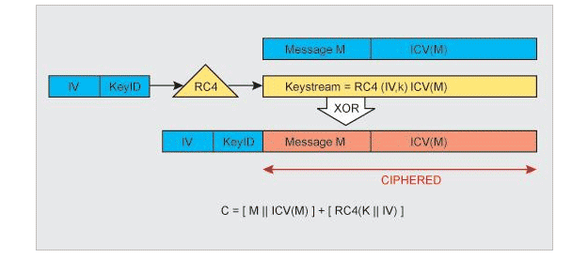
What does the protocol look like
WEP relies on a 40 or 64-bit secret key that is shared between a mobile station and an access point to encrypt and decrypt the data. This secret key is used to encrypt packets before they are transmitted, and an integrity check is used to ensure that packets are not modified in transit.
Details:
each byte of data is encrypted using a unique packet key to ensures that if a packet to is cracked the only information that is leaked is that which is contained in that particular packet.
The encryption logic used in RC4 algorithm is that the plain text is XOR-ed with an infinitely long keystream. The security of RC4 comes from the secrecy of the packet key that is derived from the keystream.

Slide 32
How breaking WEP works
Since it uses RC4 symmetric encryption, both client and AP use identical data encryption keys.
The Initialization Vector(IV) is defined as 3-byte random number generated by the computer that is either prepended or appended to the cipher text and sent to the receiver who then strips the IV off before decrypting the cipher text.
WEP eventually uses the same IV for different data packets. This results in the transmission of frames having keystreams that are too similar. If enough frames are collected based on the same IV, anyone can determine the shared values among them, that is the keystream or the shared secret key. And eventually lead to the decryption of any of the 802.11 frames.
The static nature of the shared secret keys emphasizes this problem because 802.11 doesn’t provide any function that supports the exchange of keys among stations. Hence users generally use the same keys for a very longer period of time without changing. This gives a hacker plenty of time to monitor and hack into WEP enabled networks. Hence WEP can only be implemented as a low level Security in Wireless networks.

Slide 33
Practical Example
1. Sniffing out packets and collecting weak IVs
2. Boosting traffic to the weak IVs
3. Cracking the WEP key

Slide 34
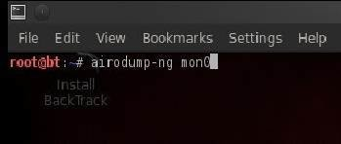
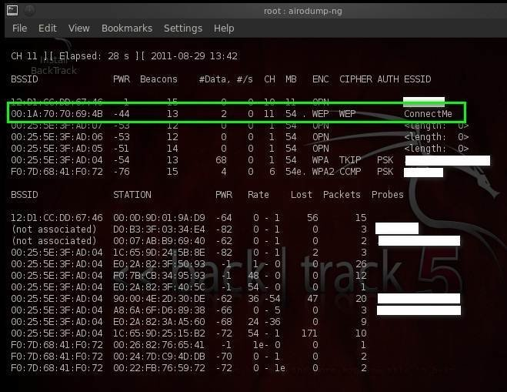
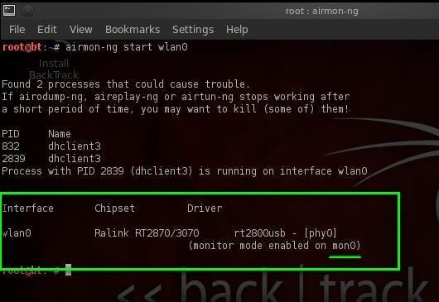
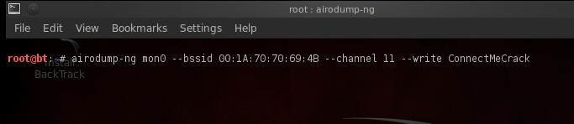
Practical Example
1. Sniffing out packets and collecting weak IVs
first use airomon-ng in this aircrack tutorial to create a promiscuous mode interface (mon0) to sniff the wireless network.
client and AP need to be in one channel to communicate.

Slide 35
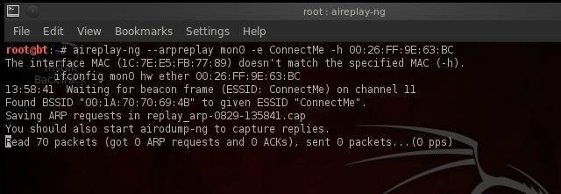
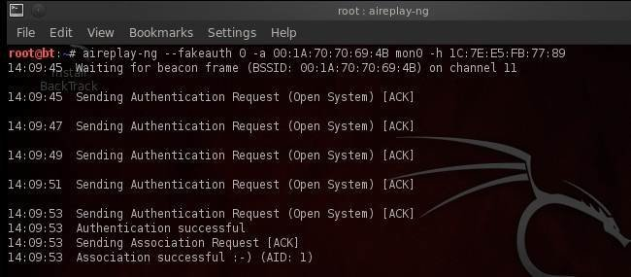
Practical Example
2. Boosting traffic to the weak IVs
we will use an arpreplay attack to boost weak IV traffic by replicating ARP requests from a legitimate device to the AP.
Two ways to boost ARP traffic in the air.
Try fake authentication with the AP
Disconnect the legitimate clients from the access point

Slide 36
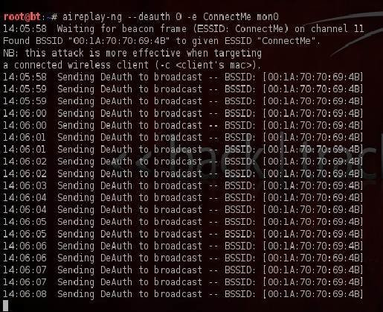
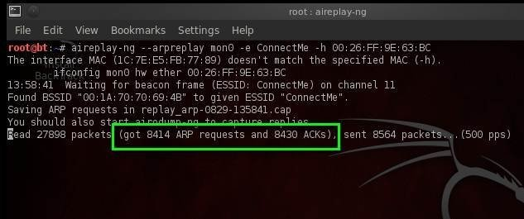
Practical Example

Slide 37
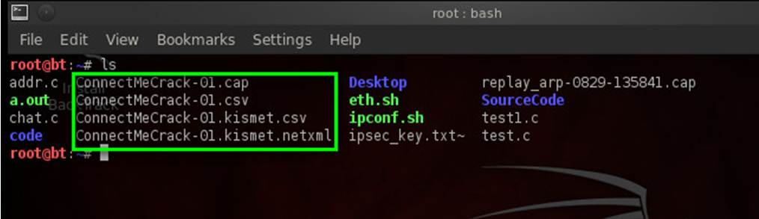
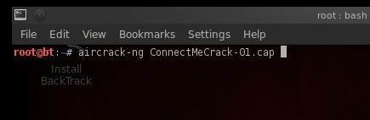
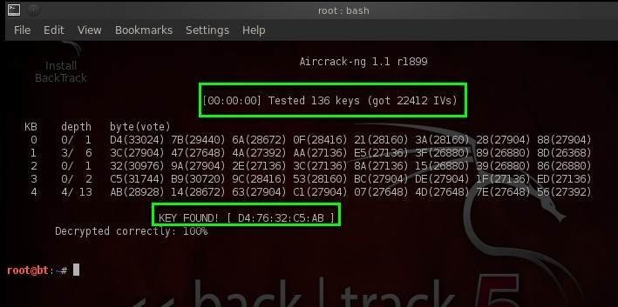
Practical Example
3. Cracking the WEP key
airodump utility created a few files on my system, that contain the collected weak IVs.
pass the cap file to a utility called aircrack-ng
Aircrack-ng uses an algorithm to guess the WEP key from the collected weak IVs. In the screenshot below, aircrack-ng cracked the WEP key using 22412 IVs

Slide 38
WHATS NEXT
WEP is old
Look at WPA and WPA2
https://www.aircrack-ng.org/doku.php?id=cracking_wpa
Examine other protocols such as Bluetooth and LGE
Pick a target device
Conduct research
Begin experimentation

Slide 39
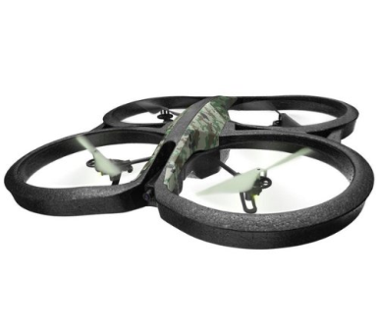


Drone attack basics
Phase 1: Drone operating normally
Phase 3: Attacker initiates connection to drone
Phase 4: Attacker operates drone
Phase 2: Drone operator disconnected by attacker

Slide 40
dronepwn basics
deauth attack
malicious access point
Requires 2 wireless cards (one in monitor mode)
Scans for drone via OUI
Disconnects every client connected to drone
Attempts to connect to drone before any other client can reconnect
Requires single wireless card
Can control multiple drones at once
Sets up an access point on the attacker’s wireless card
Sends telnet commands to drone to cause the drone to connect to attacker’s access point

